Slide 1
ATM STimulation
-by
Kevin patel
Jin HUH

Slide 2


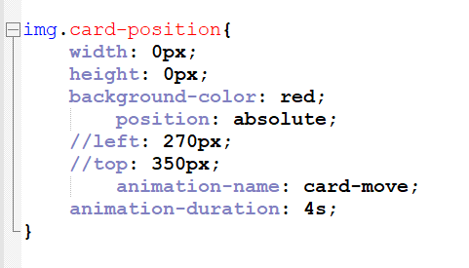
CARD insertion
Position of the card

Slide 3
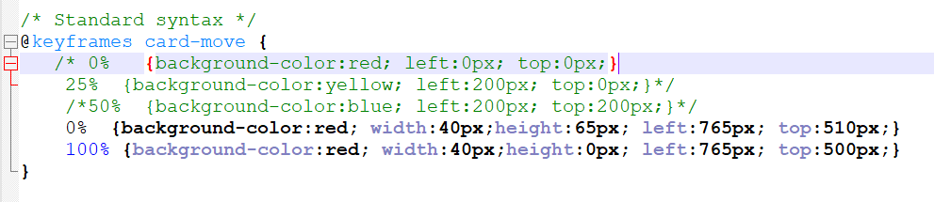
Card insertion
Card movement (using key frames)

Slide 4
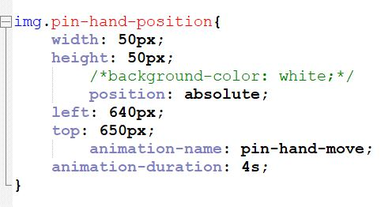
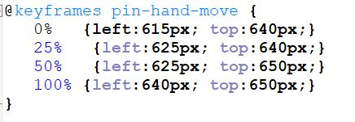
Pin entry
Hand position
Hand movement

Slide 5
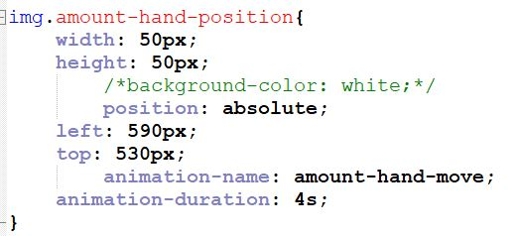
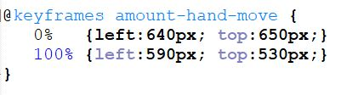
Amount selection
Position(hand)
Movement(hand)

Slide 6
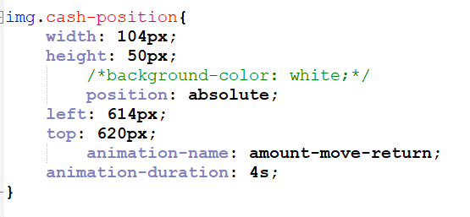
Amount
Position of the amount

Slide 7
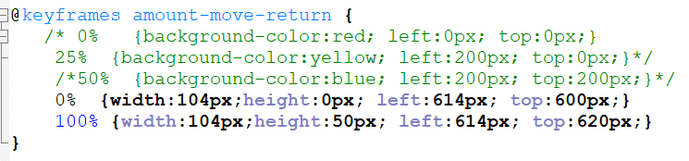
Amount
Amount movement

Slide 8
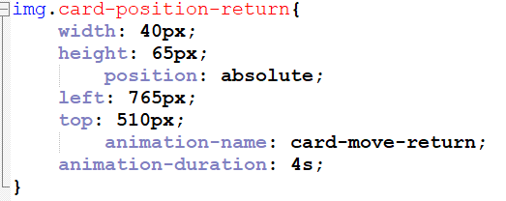
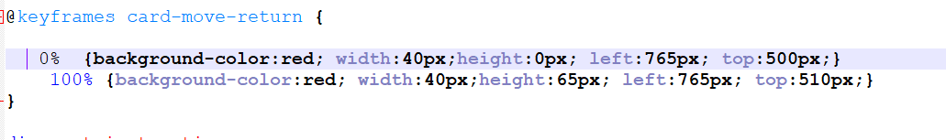
card return
position
movement

Slide 9
Thank you

